Slide 1
Gender and Age Detection using Deep Learning
Multi-output CNN model for age (regression,relu) & gender (classification, sigmoid)
Built with TensorFlow & Keras
Uses the UTKFace dataset

Slide 2
Project Overview
Predict age (numeric value) from face images
Predict gender (male/female) from face images
Model trained on thousands of labeled face images
Includes visualization, training, and real-time testing

Slide 3
Dataset (UTKFace)
Dataset: UTKFace – over 20,000 face images
Labels include: age and gender
Images pre-processed to 128x128 grayscale

Slide 4
Data Visualization
Explore dataset with histograms & plots
Age distribution across dataset
Gender distribution (male/female split)
Detect class imbalance for training insights

Slide 5
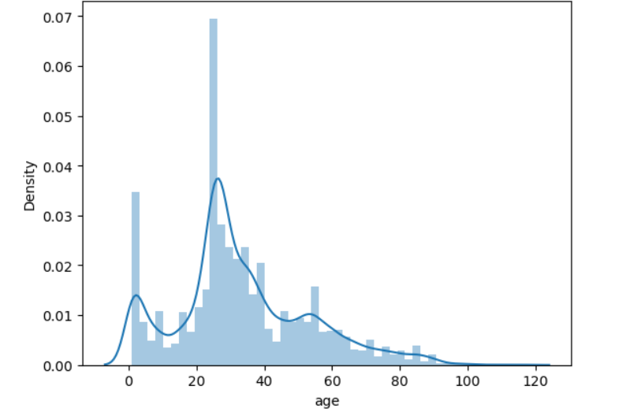
Data Visualization
Maximum density is located between 20 to 40 years

Slide 6
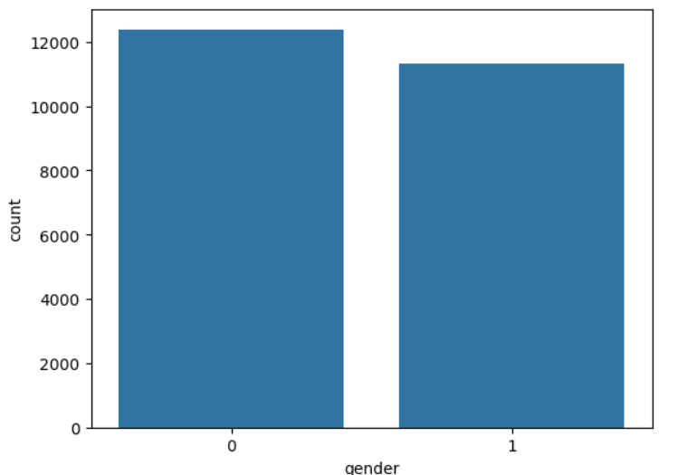
Data Visualization
0 means male and 1 means female

Slide 7
Model Architecture
Shared CNN feature extractor
Conv2D + MaxPooling layers (32 → 256 filters)
Flatten layer
Two output heads:
Gender: Dense → Dropout → Sigmoid (binary)
Age: Dense → Dropout → ReLU (regression)

Slide 8
Training the Model
Load & preprocess dataset
Train CNN for 30 epochs
Loss functions:
Gender → Binary Crossentropy
Age → Mean Absolute Error (MAE)
Save model to Models/age_gender_model.h5 & .keras

Slide 9
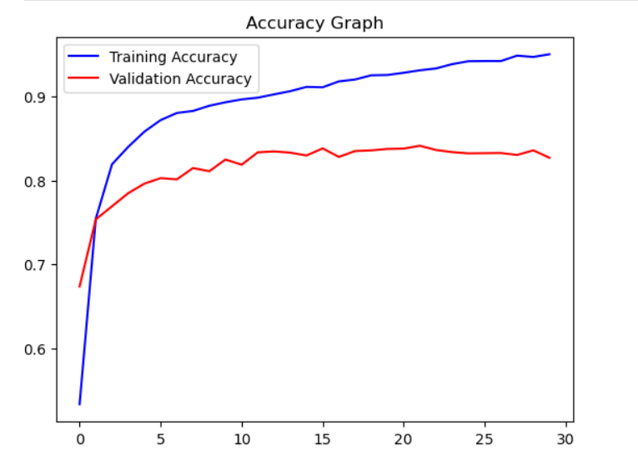
Training the Model

Slide 10
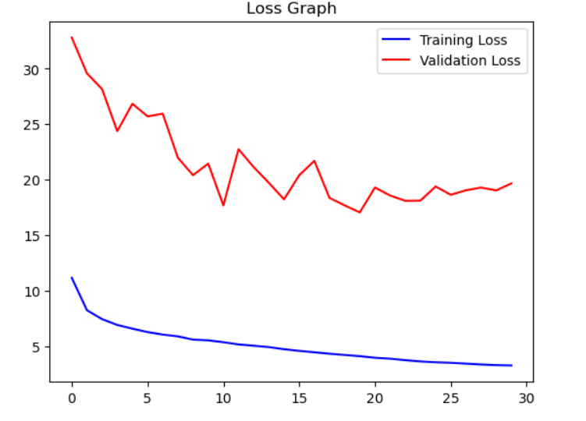
Training the Model
Loss Graph

Slide 11
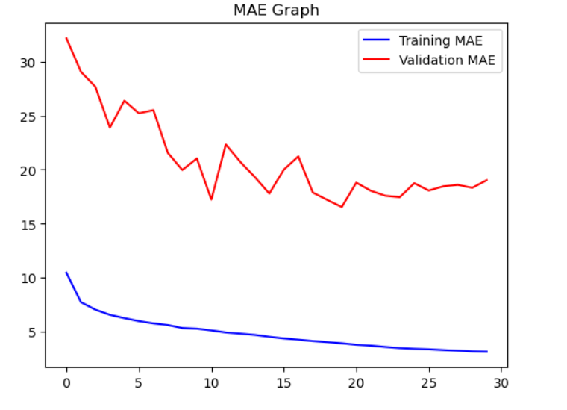
Training the Model
Mean Absolute Error

Slide 12
Real-Time Prediction
modelTesting.py loads trained model
Uses OpenCV to capture webcam feed
Detect faces → Predict age & gender
Display results on video with bounding boxes
Quit using key ‘Q'

Slide 13
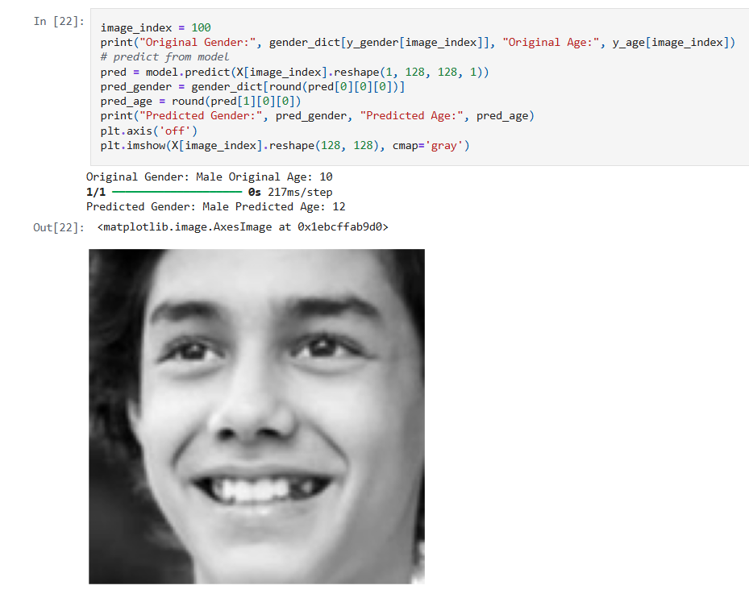

Real-Time Prediction

Slide 14
Summary
Demonstrates multi-task learning (age + gender)
CNN extracts shared features for multiple outputs
Applications: demographics analysis, smart devices, HCI
Limitations: bias in dataset, large file sizes (.h5/.keras)
Can be extended to ethnicity or emotion recognition

